Slide 1
Programming Camp-2018 SWE(PC).

Slide 2

Contents
String operation
2D Array
Number System Conversion
Prime Number(Sieve of Eratosthenes)
Data Structure (Searching)
Factorial Trailing Zero
Counting Sort
Recursion Function

Slide 3
Test case & end of file

Slide 4
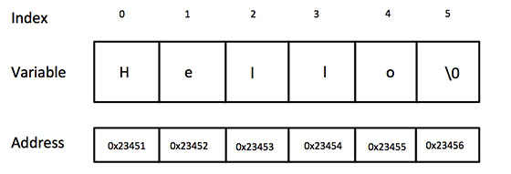
“String”
A string is a sequence of character that is treated as a single data item.
Example:
“Programming Camp-2018”
C-Code:
char n[100]="Programming Camp-2018";
Using scanf():
char n[100];
scanf("%s", n);
printf("%s\n", n);

Slide 5
Read & write Strings
Using scanf() & printf():
#include<stdio.h>
int main()
{
char n[100];
scanf("%[^\n]s", n);
printf("%s\n", n);
return 0;
}
Using gets() & puts():
#include<stdio.h>
int main()
{
char n[100];
gets(n);
puts(n);
return 0;
}

Slide 6
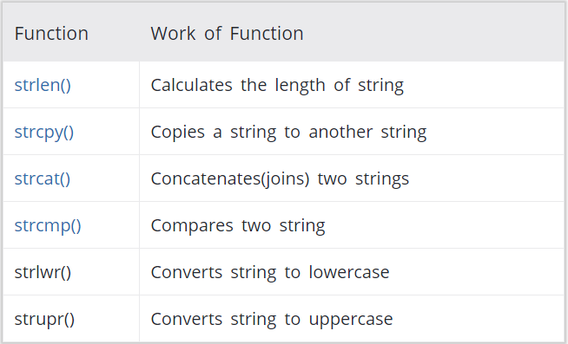
“string.h”
C supports a large number of string handling functions in the standard library "string.h".
Function’s:
strlen(String name);
strcpy(Destination string name, Source string name);
strcat(First string name, adding new string name);
strcmp(First string name, Second string name);
strlwr(String name); strupr(String name);
strrev(String name);

Slide 7
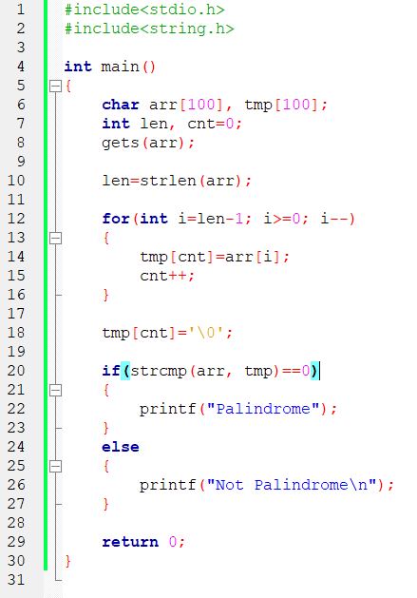
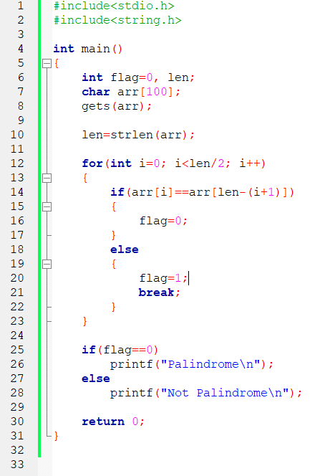

Example-1(palindrome)

Slide 8
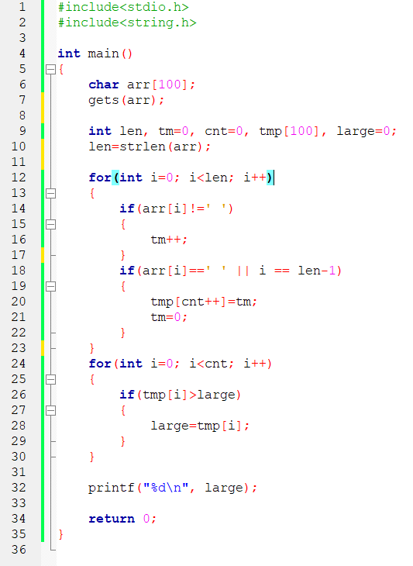
Example-2(Find largest length)

Slide 9
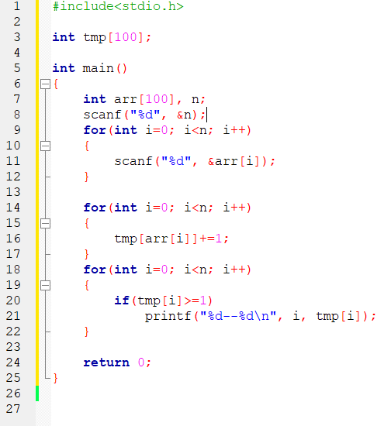
Counting sort

Slide 10
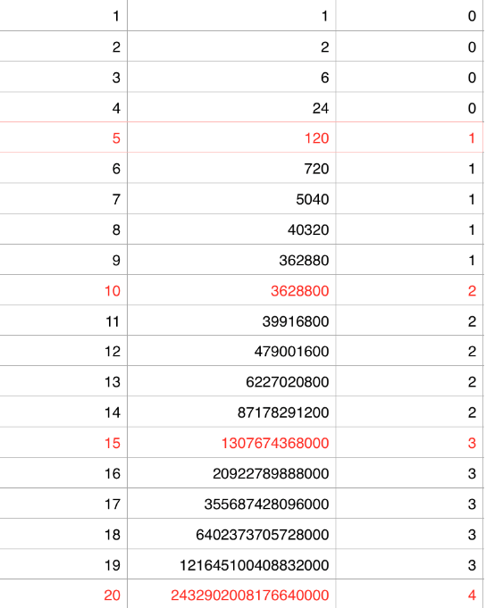
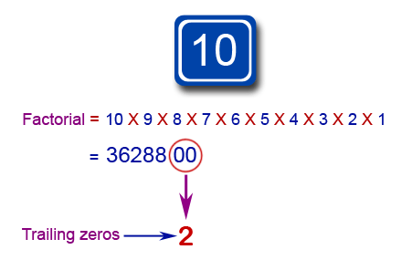
Factorial Trailing zeros
This Code Finds the Total Number of Zeroes at the End of a Factorial of any Number.

Slide 11
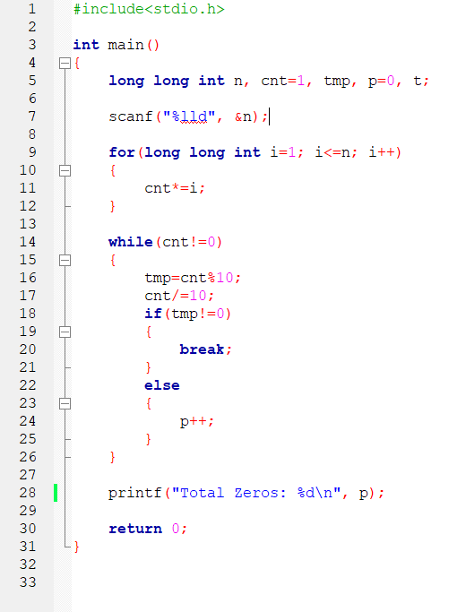
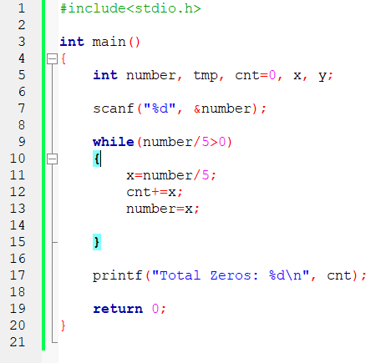
Factorial Trailing zeros(code)

Slide 12
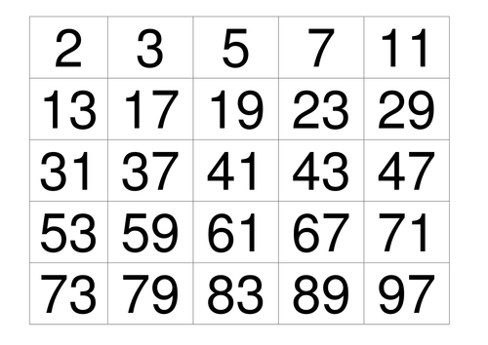
Generating Primes
Before starting the problem, you have to understand how to generate primes.
we should understand the word ‘divisible’
An integer ‘a’ is said to be divisible by an integer ‘b’ if we divide a by b, the reminder is zero.
A prime number is an integer which is divisible by exactly two different integers.
Example: Number=13
“ 13 will be prime number if 13 divisible by exactly ‘1’ and ‘13’ ”

Slide 13
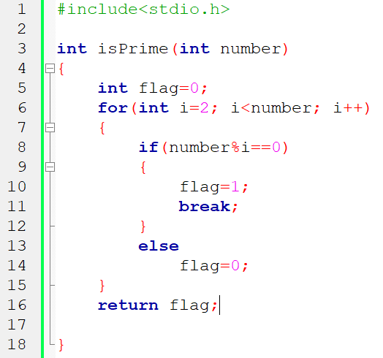
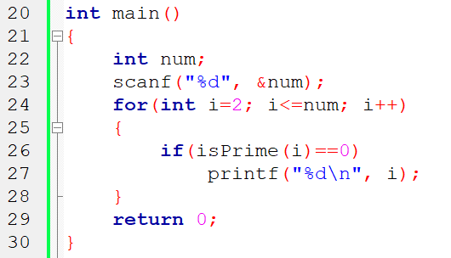
Idea 1 (divide by all possible numbers)

Slide 14
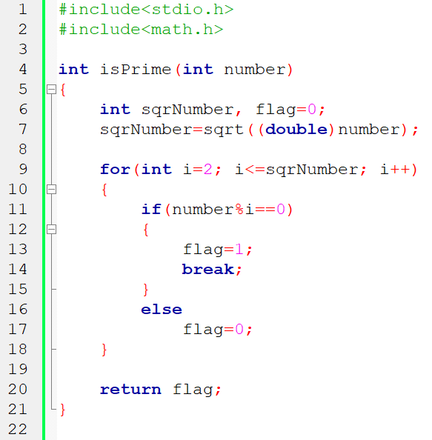
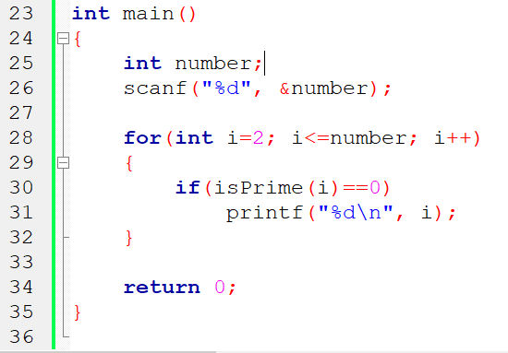
Idea 2 (divide up to square root)

Slide 15
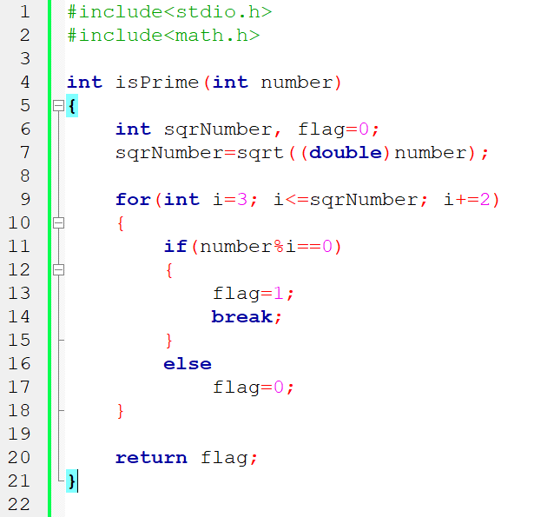
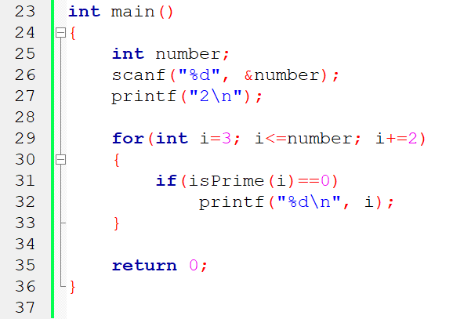
Idea 3 (no need to take even numbers)
Idea 3 (no need to take even numbers)

Slide 16
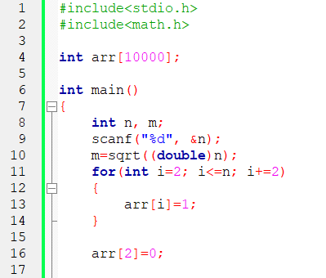
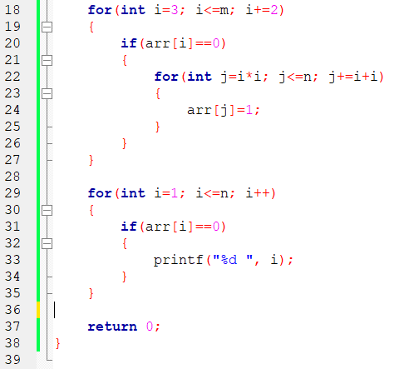
Idea 4 (Sieve of Eratosthenes)
Idea 3 (no need to take even numbers)

Slide 17
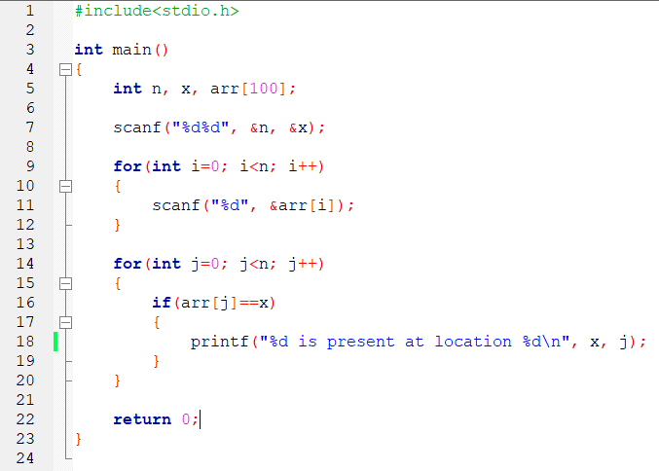
Linear search
Idea 3 (no need to take even numbers)

Slide 18
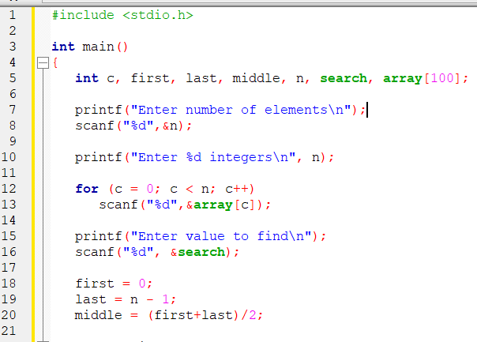
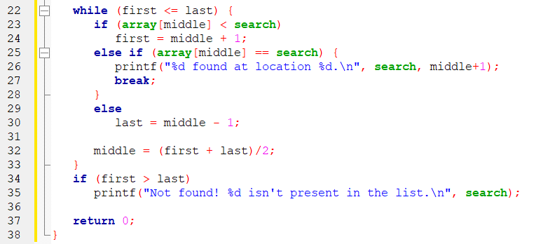
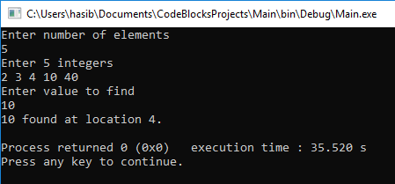
Binary search
Idea 3 (no need to take even numbers)

Slide 19
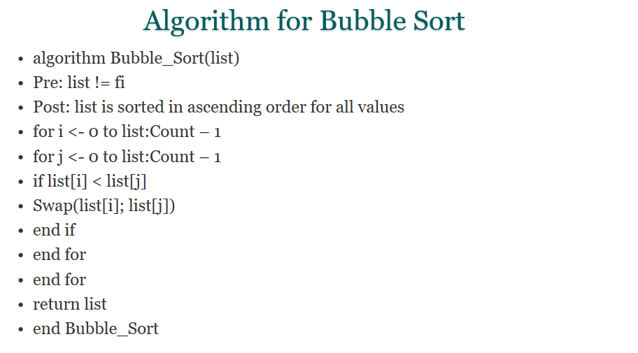
Bubble sort
Idea 3 (no need to take even numbers)

Slide 20
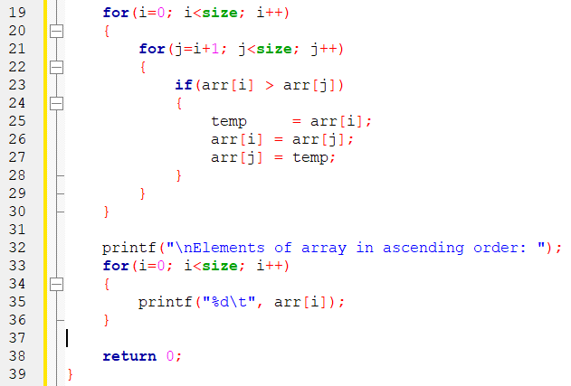
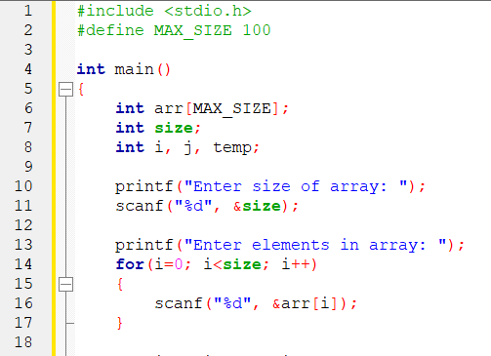
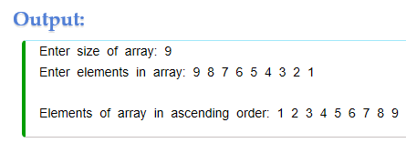
Bubble sort

Slide 21
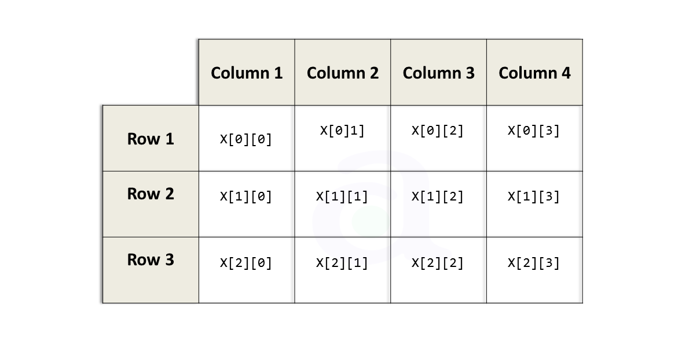
2D ARRAY
float x[3][4]
Idea 3 (no need to take even numbers)

Slide 22
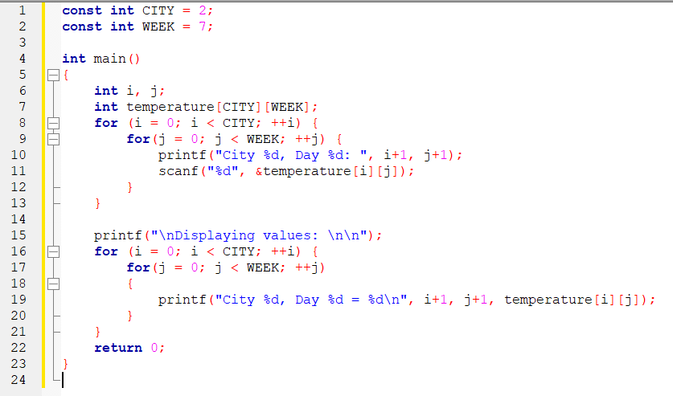
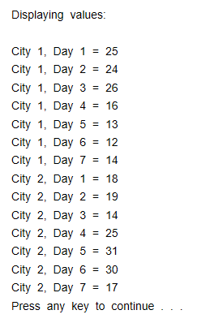
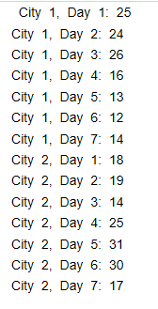
2d array
Idea 3 (no need to take even numbers)

Slide 23
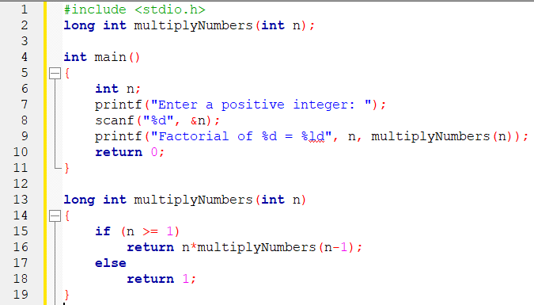
Factorial with recursion
Enter a positive integer: 6 Factorial of 6 = 720

Slide 24
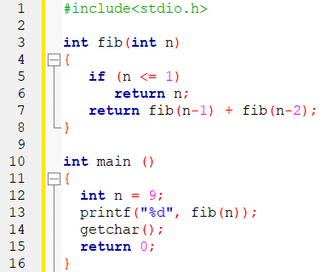
Fibonacci with recursion
Idea 3 (no need to take even numbers)
34

Slide 25
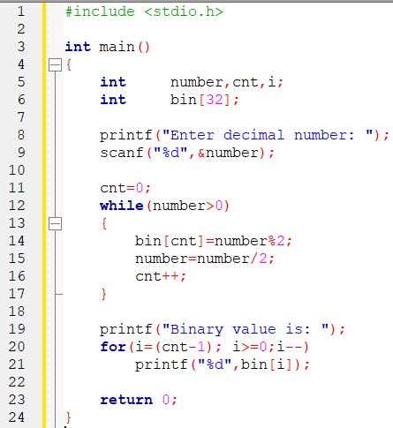
Decimal to binary
Enter decimal number: 545 Binary value is: 1000100001

Slide 26
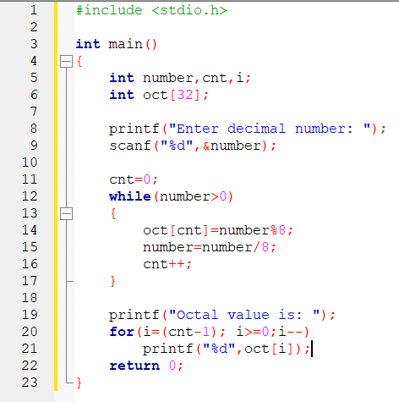
Decimal to octal
Enter decimal number: 545 Octal value is: 1041

Slide 27
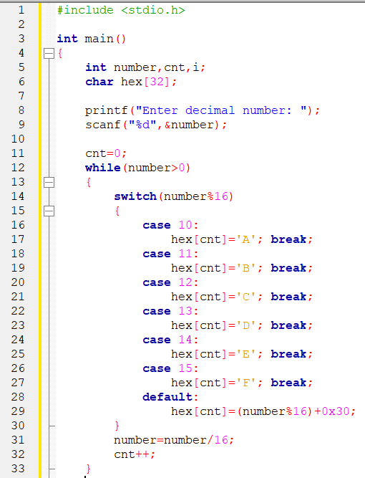
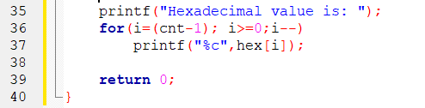
Decimal to hexadecimal
Idea 3 (no need to take even numbers)
Enter decimal number: 2806 Hexadecimal value is: AF6

Slide 28
Idea 3 (no need to take even numbers)

Slide 29
Idea 3 (no need to take even numbers)

Slide 30
Idea 3 (no need to take even numbers)

Slide 31
Idea 3 (no need to take even numbers)

